Slide 1
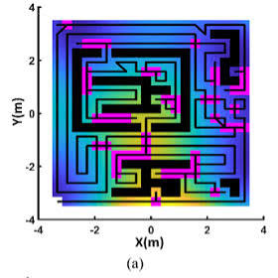
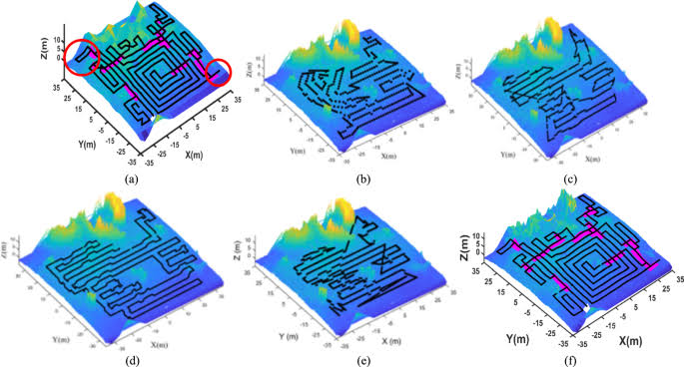




Dr. Monex Sharma
Ph.D. in Robotics · NIT Warangal
PH.D. RESEARCH
Terrain-Adaptive Multi-Objective Coverage Path Planning for Mobile Robots Using an Improved NSGA-II Algorithm
Ph. D. in Robotics and Optimization
Faculty and Research in VFSTR, Vignan University
B. Tech in Robotics and Automation course
Industrial R&D in façade-climbing robotics at WCB Robotics India Pvt Ltd (Start up firm).
Proposed NSGA-II method over (a) flat terrain (b) uneven terrain.
C++ · Python · ROS 2 · MATLAB · Gazebo
Notes:
Good morning. I am Monex Sharma. I completed my Ph.D. in Robotics at NIT Warangal, where my thesis developed a terrain-adaptive, multi-objective coverage path planner for mobile robots based on an improved NSGA-II. My background is B.Tech in Robotics and Automation, and I have both research and industrial experience in mobile robotics, working day to day in C++, Python, ROS 2, MATLAB and Webots.

Slide 2





Research Credentials
RESEARCH AREAS
RESEARCH EXPERIENCE
Mobile Robot Navigation
01
Developed multi-objective optimization-based path planning methods for mobile robots
Coverage Path Planning
02
Validated work in simulation and on real mobile robot platforms
Multi-Objective Optimization
03
Industrial experience in SLAM, localization, sensor fusion and motion planning
Localization and Sensor Fusion
04
Peer-reviewed publications in mobile robotics and path planning
Autonomous Mobile Robots
Notes:
My work sits at the intersection of navigation, coverage path planning and multi-objective optimization, with localization and sensor fusion underneath it. I have taken methods from formulation through simulation to real hardware, and my industrial experience in SLAM and motion planning keeps that work grounded in what actually deploys.

Slide 3
Industrial Work Experience
WCB Robotics India Pvt Ltd · Robotics Software Engineer
SENSORS & HARDWARE
ENGINEERING CONTRIBUTIONS
Encoder
01
Implemented Kalman filter-based sensor fusion across encoder, barometer, IMU and IR sensor data
Barometer
02
Engineering code design for gear profile using Python
IMU
03
Calibration of ToF (Time-of-Flight) sensor for accurate range sensing
IR Sensor
04
Slip detection using the ICR (Instantaneous Center of Rotation) technique
ToF Sensor

Slide 4

Ongoing Research
CURRENT RESEARCH FOCUS
CURRENT STUDENT PROJECT
Uncertainty-aware mobile robot navigation
Autonomous Search and Rescue Mobile Robot
Localization and sensor fusion
Guiding 4 UG students team building a full autonomy stack on a physical platform.
Navigation in unknown environments
ROS 2
Sensors
Localization
Dynamic obstacle avoidance
Navigation
Obstacle Avoidance
Autonomous exploration and mapping
Notes:
Currently I am focused on uncertainty-aware navigation: making localization, exploration and obstacle avoidance robust when the map and the sensing are both imperfect. That research feeds directly into the student project I am guiding, an autonomous search-and-rescue robot built on ROS 2 with a complete perception-to-navigation stack.

Slide 5


Future Research Plan
Short-Term
Long-Term
Robust localization and navigation
AI-assisted autonomous navigation
Unknown and dynamic environments
Multi-robot exploration
Improved coverage path planning
Search and rescue robotics
Real-world experimental validation
Industry and academic collaboration
RESEARCH GOAL
Reliable autonomous mobile robots for real-world environments
Notes:
In the short term I want to harden localization and navigation for unknown and dynamic environments and extend my coverage planning work. Longer term I am aiming at AI-assisted navigation, multi-robot exploration and search-and-rescue, always validated on real hardware and, wherever possible, with industry partners. The single goal behind all of it is reliability in the real world.

Slide 6





Teaching Plan
Fundamentals
›
Programming
›
Simulation
›
Hardware
›
Project
Robotics and Autonomous Systems
ROS 2 and Robot Programming
C++ and Python
Computer Vision
Control Systems
Design Thinking & Project-Based Learning
TEACHING GOAL
Strong fundamentals, hands-on robotics implementation and research-oriented projects.
“My aim is to integrate teaching, research and practical robotics experience to develop capable students and contribute to reliable autonomous robotic systems.”
Notes:
My teaching follows one arc: fundamentals, then programming, then simulation, then hardware, then an open project. I can teach robotics and autonomous systems, ROS 2, C++ and Python, computer vision and control systems, and I like running design-thinking and project-based courses. To close: my aim is to integrate teaching, research and practical robotics experience to develop capable students and contribute to reliable autonomous robotic systems. Thank you.

Slide 7
Journal Publications
Sharma, Monex, and Hari Kumar Voruganti. "Multi-objective optimization approach for coverage path planning of mobile robot." Robotica (2024): 1-25. SCIE, IF – 2.7, Q2.
Sharma, Monex, and Hari Kumar Voruganti. "Energy-Efficient Coverage Path Planning for Mobile Robots on Uneven Terrain via the TA-NSGA-II Approach." Arabian Journal of Science and Engineering (2025): 1-23. SCIE, IF – 2.9, Q1.
Sharma, Monex, and Hari Kumar Voruganti. "Implementation of Coverage Path Planning Based on Modified NSGA-II and Kalman Filter on GoPiGo3 Robot.” International Journal of Automation and Smart Technology. Scopus Journal.
Sharma, Monex, and Hari Kumar Voruganti. "Improved NSGA-II for offline coverage path planning with reactive velocity adaptation for moving obstacles in known environments.” Target Journal: Robotics and Autonomous Systems (RAS)
Sharma, Monex. “Localization-Aware Search and Rescue Navigation with Autonomous Return to Known Locations.” Target Journal: Industrial Robot (Emerald Publishing)

Slide 8
Conference Publications
Monex Sharma, and Hari Kumar Voruganti. "An Effective Genetic Algorithm based Multi-Objective Optimization Approach for Coverage Path Planning of Mobile Robot." International Conference on Advancements in Interdisciplinary Research (AIR-2022), 6th - 7th May 2022 at MNNIT Allahabad, Prayagraj, India, Scopus Indexed.
Sharma, Monex, and Hari Kumar Voruganti. "Preference Based Multi-Objective Optimization Techniques for Coverage Path Planning of a Mobile Robot." In Proceedings of the 2023 6th International Conference on Advances in Robotics, pp. 1-6. 2023, IIT Ropar. Scopus Indexed.
Sharma, Monex, and Hari Kumar Voruganti. "A Classical Multi-objective Approach for Coverage Path Plans for a Mobile Robot in an Uneven Terrain." 6th National Conference on Multidisciplinary Design, Analysis and Optimization, 2023, IIT Guwahati. Scopus Indexed.

